Slide 1


SQL DATABASE ANALYSIS
ATTENDANCE
MANAGEMENT SYSTEM
PRESENTED BY: RAJ BARI

Slide 2
INTRODUCTION
The Attendance Management System is an SQL-based database designed to efficiently manage employee attendance and related information. It stores details of employees, departments, attendance records, holidays, leave requests, and work schedules. The system uses SQL queries to track attendance, analyse working hours, manage leaves, and generate useful information for better attendance management.

Slide 3
PROBLEM STATEMENT
To manage and analyse employee attendance data by tracking employees, departments, attendance, holidays, leave requests, and work schedules using SQL.

Slide 4



PROJECT OBJECTIVES
To analyse employee attendance data related to employees, departments, attendance records, holidays, leave requests, and work schedules using SQL.
To apply SQL concepts such as JOINS, Aggregate Functions, GROUP BY, HAVING, CASE Statements, Subqueries, and LIMIT to retrieve meaningful information from the attendance database.
To generate meaningful insights from the attendance database, such as late and absent employees, approved leave requests, attendance duration, average working hours, and employees working on holidays.

Slide 5
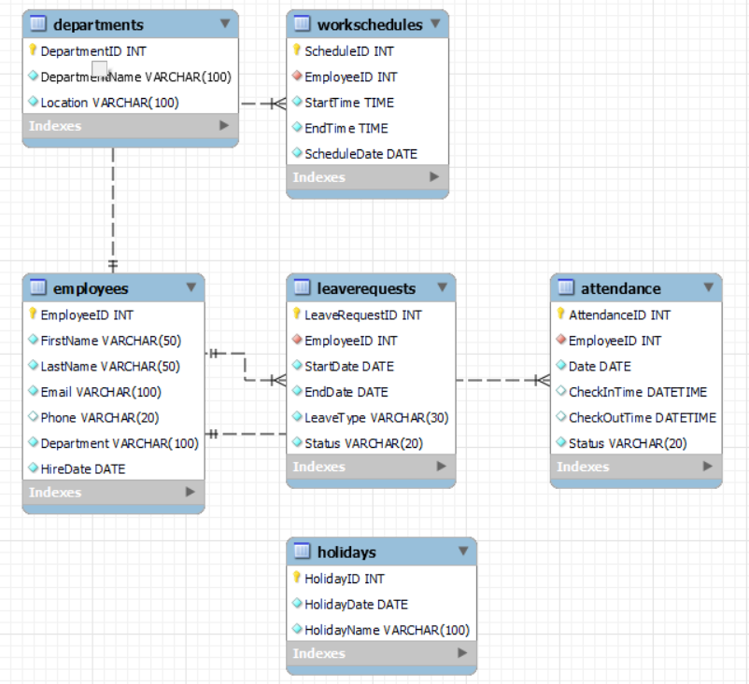
EER Diagram
The EER diagram illustrates the logical structure of the Attendance Management System database. It represents six main entities: Employees, Departments, Attendance, Holidays, Leave Requests , Work Schedules, and their relationships using primary keys and foreign keys.

Slide 6
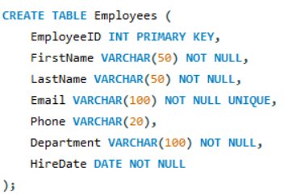
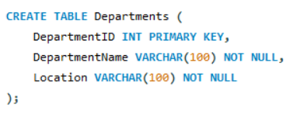
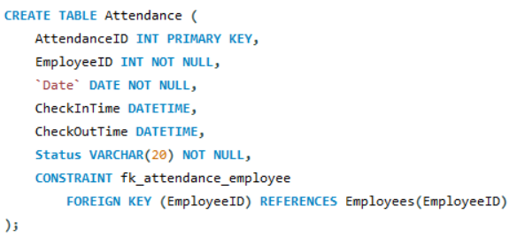
1.Create Tables

Slide 7
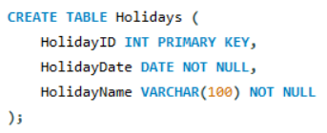
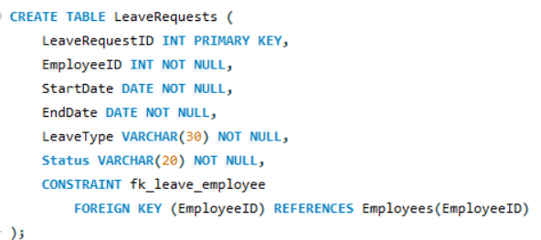
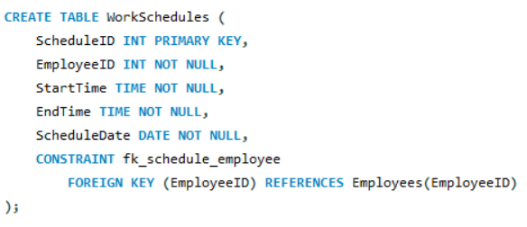
1.CREATE TABLES
ANALYSIS
The database has been successfully designed with six tables — Employees, Departments, Attendance, Holidays, Leave Requests, and Work Schedules, covering all the major requirements of the Attendance Management System.

Slide 8
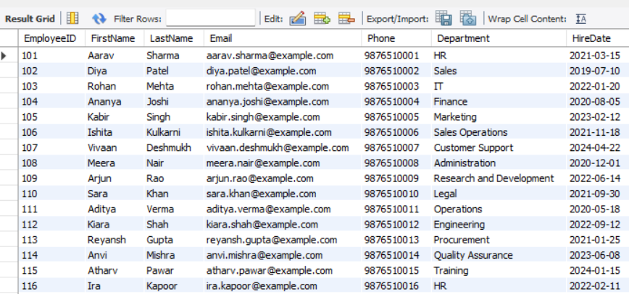
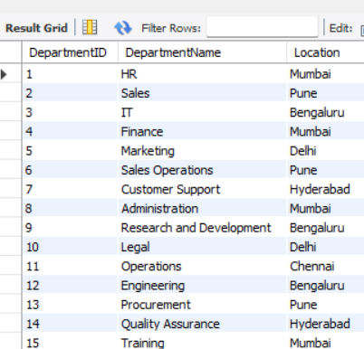
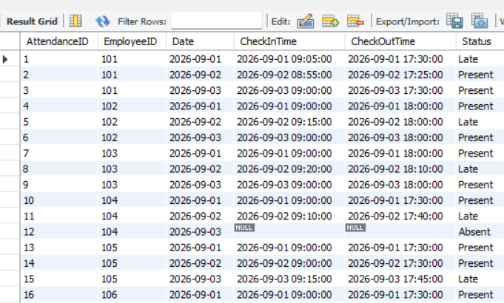
2.INSERT RECORDS

Slide 9
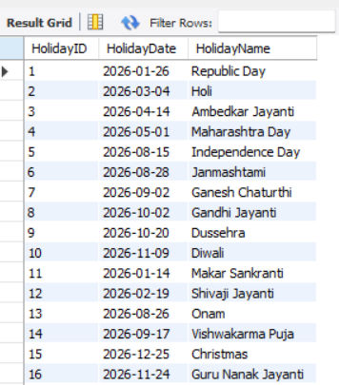
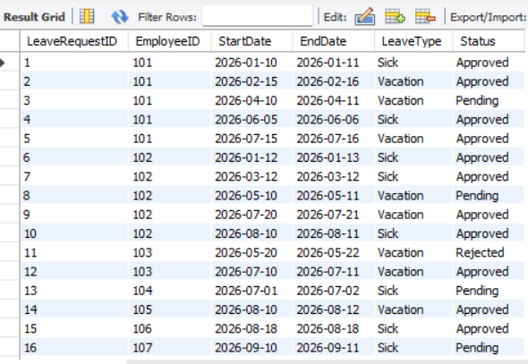
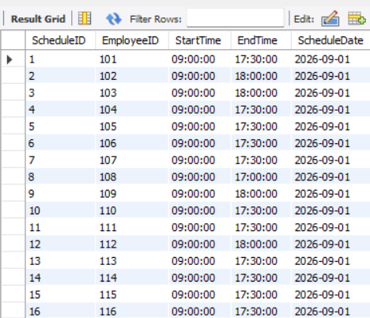
2.INSERT RECORDS
ANALYSIS
The database has been successfully populated with sample records across all six tables — Employees, Departments, Attendance, Holidays, Leave Requests, and Work Schedules, providing sufficient data for SQL analysis.
The inserted records maintain primary key and foreign key relationships, ensuring data integrity and referential consistency across the Attendance Management System.

Slide 10

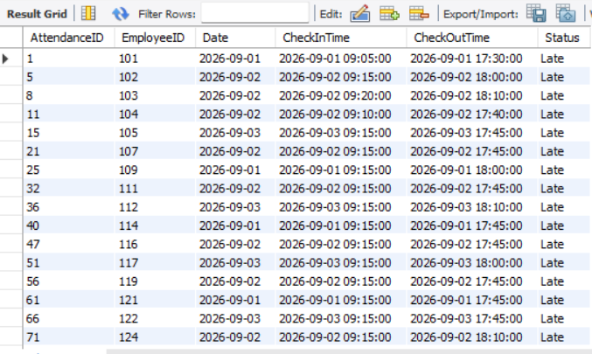
Data Retrieval Queries
-- Select Records
Write a query to select all attendance records from the Attendance table where the Status is 'Late'.
Question 3 -
Query -
Output -
Analysis -
• The query retrieves all attendance records where the employee's status is marked as 'Late'.
• It helps the organization identify and monitor employees who arrive late to work.

Slide 11


Data Retrieval Queries
-- WHERE CLAUSE (AND)
Write a query to select all employees from the Employees table who work in the 'HR' department and were hired after January 1, 2020.
Question 4 -
Query -
Output -
Analysis -
• The query retrieves employees who work in the HR department and were hired after January 1, 2020.
• It helps the organization identify HR employees based on their department and hiring date

Slide 12

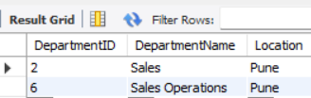
Data Retrieval Queries
-- LIKE OPERATOR
Write a query to select all departments where the DepartmentName contains 'Sales'.
Question 5-
Query -
Output -
Analysis -
• The query retrieves departments whose DepartmentName contains the word “Sales”.
• It helps to identify departments related to Sales from the department records.

Slide 13
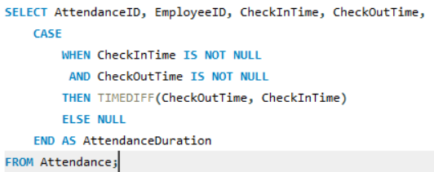
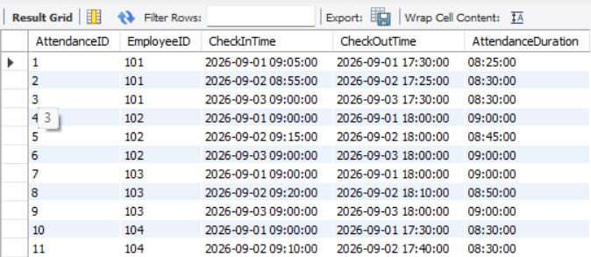
Data Retrieval Queries
-- Case Statement
Write a query to select CheckInTime, CheckOutTime, and a new column AttendanceDuration from the Attendance table. -- Calculate AttendanceDuration as the difference between CheckOutTime and CheckInTime.
Question 6 -
Query -
Output -
Analysis -
The query calculates AttendanceDuration as the difference between CheckInTime and CheckOutTime.
It helps analyze the number of hours employees spend at work.

Slide 14
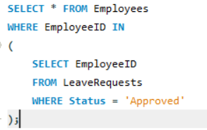
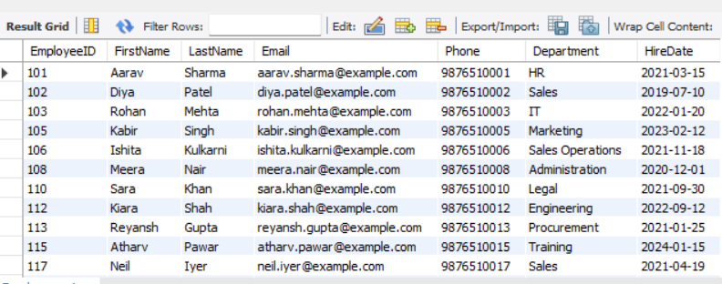
Data Retrieval Queries
-- SUBQUERY
Write a query to find all employees who have at least one 'Approved' leave request. Use a subquery in the WHERE clause to find these EmployeeIDs.
Question 7-
Query -
Output -
Analysis -
The query retrieves employees who have at least one approved leave request.
It uses a subquery in the WHERE clause to find employees with Status = 'Approved'.

Slide 15
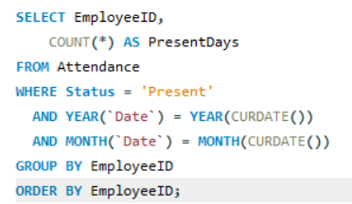
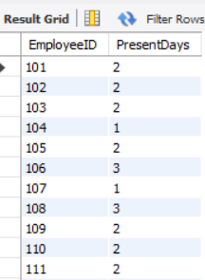
Data Retrieval Queries
-- GROUP BY
Write a query to get the total number of days each employee was present in the current month. Group the results by EmployeeID.
Question 8 -
Query -
Output -
Analysis -
The query calculates the total number of Present days for each employee in the current month.
It uses GROUP BY EmployeeID to group attendance records employee-wise.

Slide 16
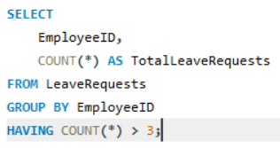
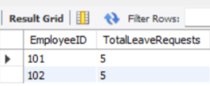
Data Retrieval Queries
-- HAVING CLAUSE
Write a query to get the total number of leave requests for each employee, but only include employees with more than 3 leave requests. Use the HAVING clause.
Question 9-
Query -
Output -
Analysis -
The query calculates the total number of leave requests for each employee.
It uses the HAVING clause to include only employees with more than 3 leave requests.

Slide 17
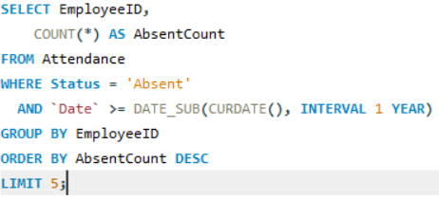
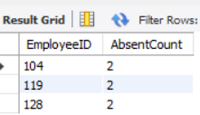
Data Retrieval Queries
-- LIMIT
Write a query to select the top 5 employees with the most number of 'Absent' statuses in the past year.
Question 10
Query -
Output -
Analysis -
The query identifies employees with the highest number of Absent statuses during the past year.
It uses ORDER BY and LIMIT 5 to display the top five results.

Slide 18
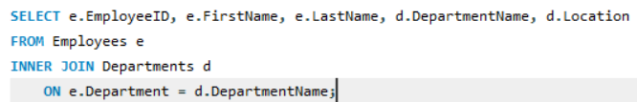
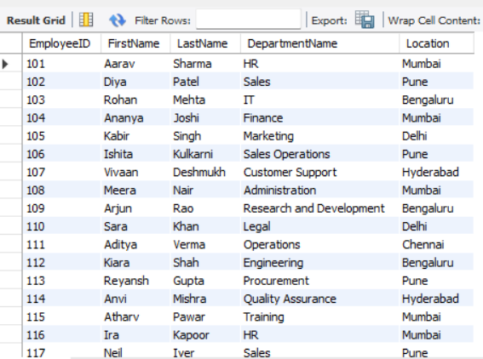
Data Retrieval Queries
-- INNER JOIN
Write a query to join Employees with Departments to get a list of all employees with their department names.
Question 11
Query -
Output -
Analysis -
The query joins Employees and Departments to display employee details with their department names.
It helps view employee information along with their respective department and location.

Slide 19
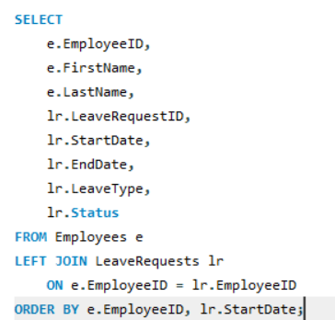
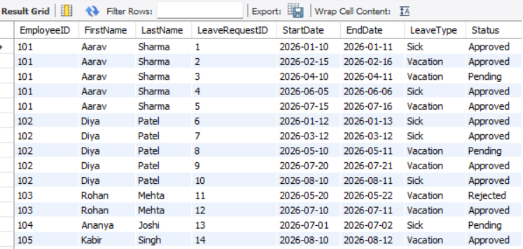
Data Retrieval Queries
-- OUTER JOIN
Write a query to get a list of all employees and any associated LeaveRequests. Include employees who might not have any leave requests.
Question 12
Query -
Output -
Analysis -
The query retrieves all employees along with their associated leave request details using a LEFT JOIN.
It also includes employees who do not have any leave requests.

Slide 20
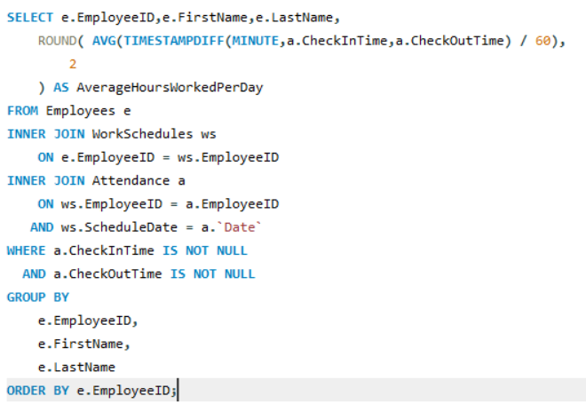
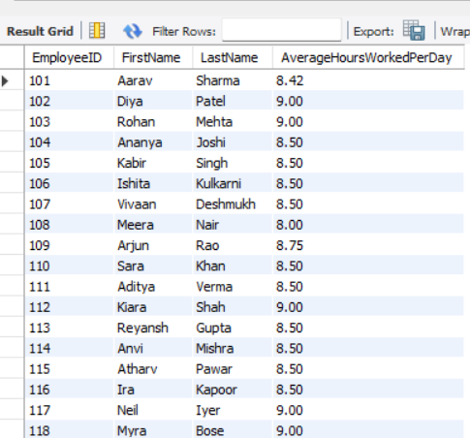
Data Retrieval Queries
-- JOIN WITH AGGREGATION
Write a query to get the average number of hours worked per day for each employee. Use an INNER JOIN between WorkSchedules and Attendance, and group by EmployeeID.
Question 13
Query -
Output -
Analysis -
The query calculates the average number of hours worked per day for each employee using Attendance and WorkSchedules data.
It uses INNER JOIN and GROUP BY EmployeeID to calculate the average working hours employee-wise.

Slide 21
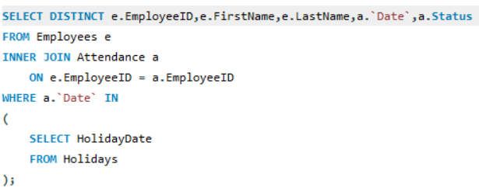
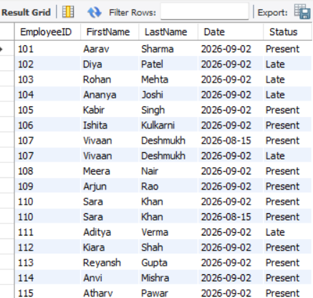
Data Retrieval Queries
-- SUBQUERY WITH JOIN
Write a query to find all employees who have worked on days that are holidays. Use a subquery to filter dates that are in the Holidays table.
Question 14
Query -
Output -
Analysis -
The query identifies employees who have attendance records on holiday dates.
It uses a subquery with the Holidays table to filter attendance dates that match holidays.

Slide 22
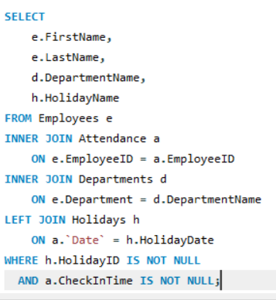
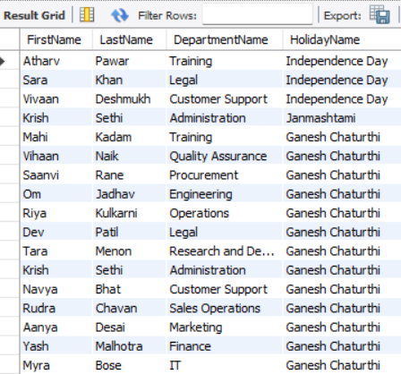
Data Retrieval Queries
-- ADVANCED JOIN
Write a query to list FirstName, LastName, DepartmentName, and HolidayName for all employees who have their CheckInTime on a holiday. -- Use INNER JOIN and LEFT JOIN as necessary to get all required details.
Question 15
Query -
Output -
Analysis -
The query lists FirstName, LastName, DepartmentName, and HolidayName for employees who checked in on a holiday.
It uses INNER JOIN and LEFT JOIN to combine employee, department, attendance, and holiday details.

Slide 23
CONCLUSION
The Attendance Management System successfully demonstrates how SQL can be used to efficiently manage, analyse, and generate meaningful insights from employees , department, attendance, holiday, leave requests and work schedule data.

Slide 24

Thank You!

